Slide 1
Section 3: Neural Networks

Slide 2
Outline
Neural Network basics
Backpropagation
CNNs
RNNs
Transformers

Slide 3
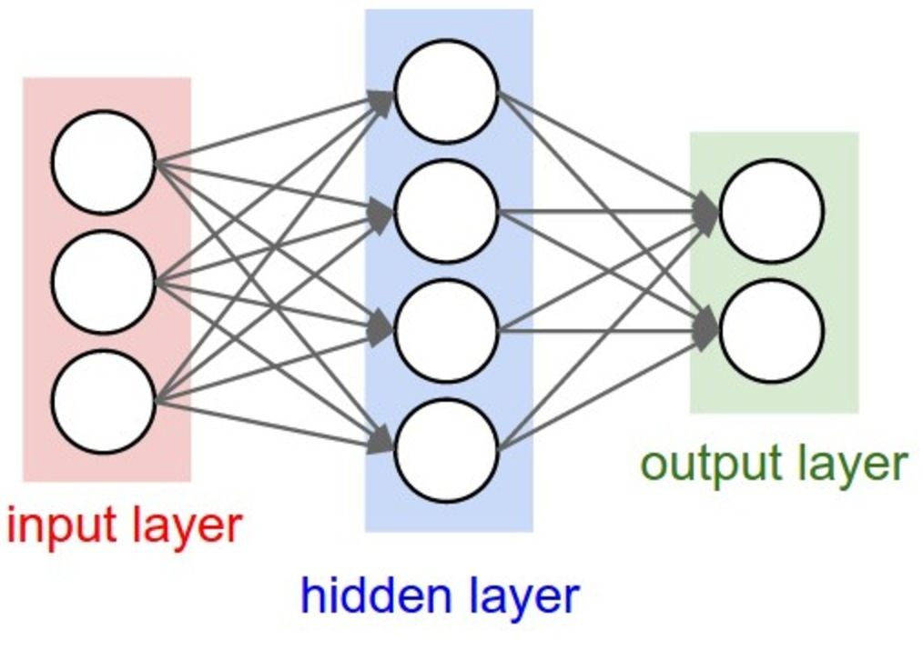
Neural Network (NN) Basics
Dataset: (x, y) where x: inputs, y: labels
Steps to train a 1-hidden layer NN:
● Do a forward pass: ŷ = f(xW + b)
● Compute loss: loss(y, ŷ)
● Compute gradients using backprop
● Update weights using an optimization
algorithm, like SGD
● Do hyperparameter tuning on Dev set
● Evaluate on Test set

Slide 4
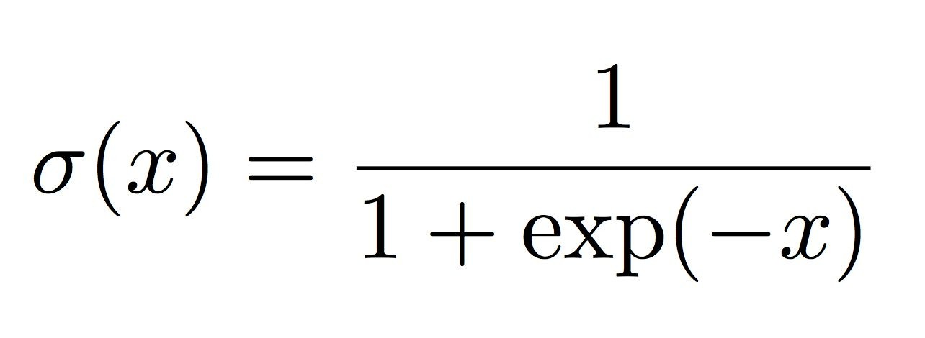
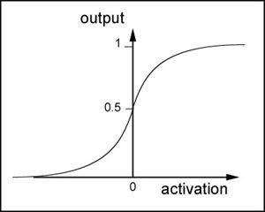
Activation Functions: Sigmoid
Properties:
● Squashes input between 0 and 1.
Problems:
● Saturation of neurons kills gradients.
● Output is not centered at 0.

Slide 5
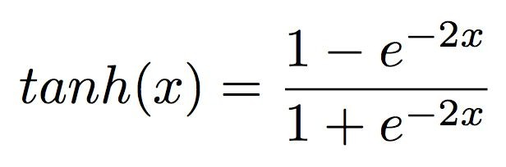
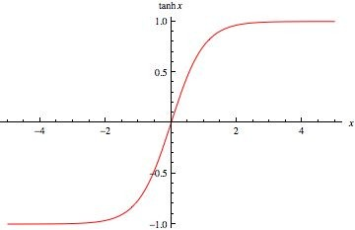
Activation Functions: Tanh
Properties:
● Squashes input between -1 and 1.
● Output centered at 0.
Problems:
● Saturation of neurons kills gradients.

Slide 6
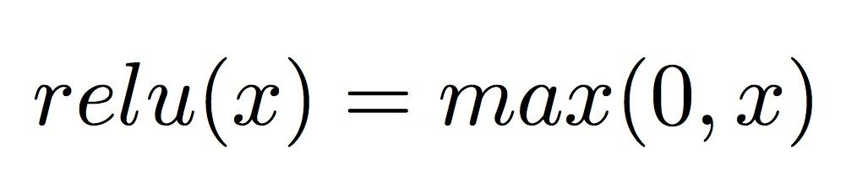
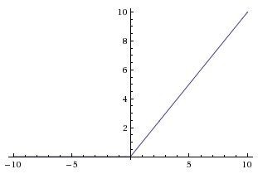
Activation Functions: ReLU
Properties:
● No saturation
● Computationally cheap
● Empirically known to converge faster
Problems:
● Output not centered at 0
When input < 0, ReLU gradient is 0. Never changes.

Slide 7
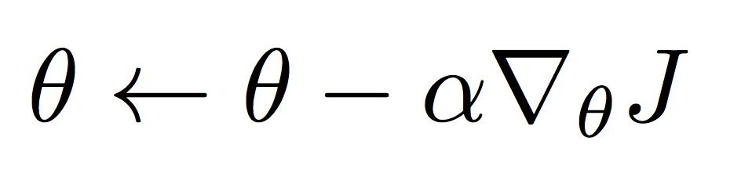
Stochastic Gradient Descent (SGD)
● Stochastic Gradient Descent (SGD)
○ 𝝷 : weights/parameters
○ 𝛂 : learning rate
○ J : loss function
SGD update happens after every training
example.
● Minibatch SGD (sometimes also
abbreviated as SGD) considers a small
batch of training examples at once,
averages their loss, and updates 𝝷.

Slide 8
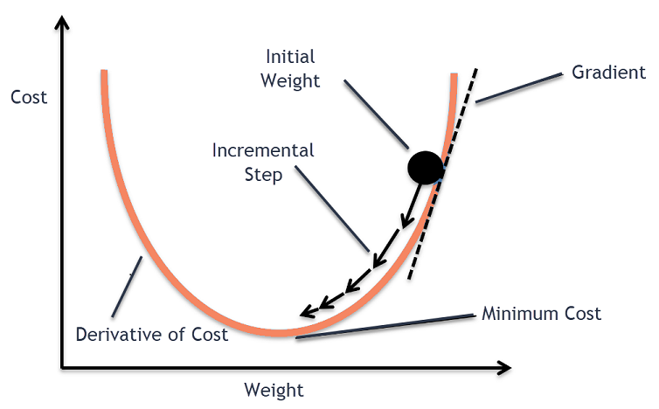

Slide 9
Backpropagation
Problem statement
Simple example

Slide 10

Problem Statement
Given a function f with respect to inputs x, labels y, and parameters 𝜃
compute the gradient of Loss with respect to 𝜃

Slide 11
Backpropagation
An algorithm for computing the gradient of a compound function as a
series of local, intermediate gradients

Slide 12
Backpropagation
1. Identify intermediate functions (forward prop)
2. Compute local gradients
3. Combine with upstream error signal to get full gradient

Slide 13



Modularity - Simple Example
Compound function
Intermediate Variables
(forward propagation)

Slide 14
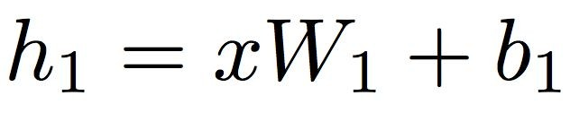
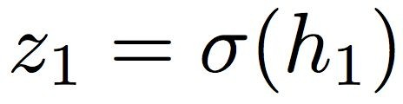

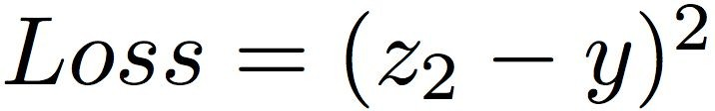
Modularity - Neural Network Example
Compound function
Intermediate Variables
(forward propagation)

Slide 15
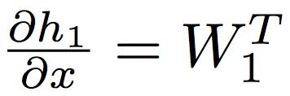
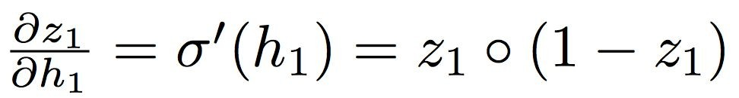


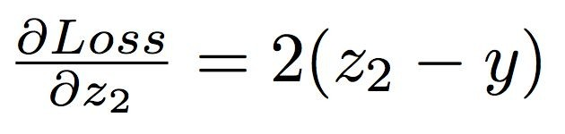
Intermediate Variables
(forward propagation)
Intermediate Gradients
(backward propagation)

Slide 16
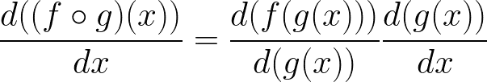
Chain Rule Behavior
Key chain rule intuition:
Slopes multiply

Slide 17
Backprop Menu for Success
1. Write down variable graph
2. Compute derivative of cost function
3. Keep track of error signals
4. Enforce shape rule on error signals
5. Use matrix balancing when deriving over a linear transformation

Slide 19
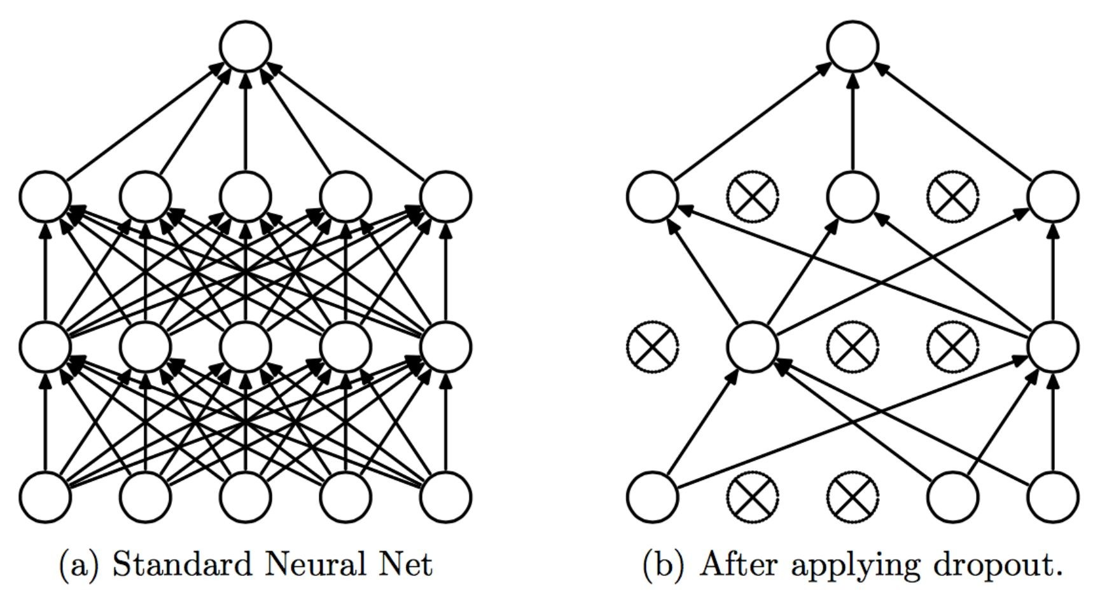
Regularization: Dropout
Randomly drop neurons at forward
pass during training.
● At test time, turn dropout off.
Prevents overfitting by forcing
network to learn redundancies.
Think about dropout as training an ensemble of networks.

Slide 20
Training Tips and Tricks
● Learning rate:
○ If loss curve seems to be unstable
(jagged line), decrease learning rate.
○ If loss curve appears to be “linear”,
increase learning rate.
loss
very high learning rate
low learning rate
high learning rate
good learning rate

Slide 21
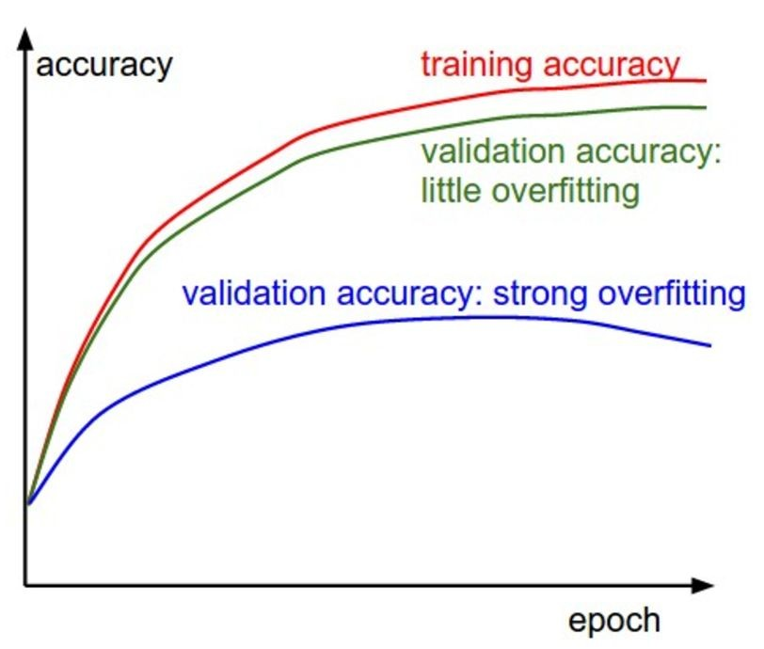
Training Tips and Tricks
● Regularization (Dropout, L2 Norm, … ):
If the gap between train and dev
accuracies is large (overfitting),
increase the regularization constant.
DO NOT test your model on the test set until
overfitting is no longer an issue.

Slide 22
CNNs
Fully-Connected Layers
Convolutional Layers

Slide 23
Fully
Connected
Layer
32x32x3 image -> stretch to 3072 x 1
input
activation
1
10 x 3072
1
₃₀₇₂
₁₀
weights
Fei-Fei Li & Justin Johnson & Serena Yeung Lecture 5 23 April 17, 2018
April 17, 2018
Fei-Fei Li & Justin Johnson & Serena Yeung Lecture 5 -
-

Slide 24
Fully
Connected
Layer
32x32x3 image -> stretch to 3072 x 1
input
activation
1
10 x 3072
1
₃₀₇₂
₁₀
weights
1 number:
the result of taking a dot product between a row of W and the input
(a 3072-dimensional dot product)
Fei-Fei Li & Justin Johnson & Serena Yeung Lecture 5 24 April 17, 2018
April 17, 2018
Fei-Fei Li & Justin Johnson & Serena Yeung Lecture 5 -
-

Slide 25
Convolution
Layer
32x32x3 image -> preserve spatial structure
₃₂ height
₃₂ width
3
depth
Fei-Fei Li & Justin Johnson & Serena Yeung Lecture 5 25 April 17, 2018
April 17, 2018
Fei-Fei Li & Justin Johnson & Serena Yeung Lecture 5 -
-

Slide 26
Convolution
Layer
32x32x3 image
5x5x3 filter
₃₂
Convolve the filter with the image
i.e. “slide over the image spatially,
computing dot products”
₃₂
3
Fei-Fei Li & Justin Johnson & Serena Yeung Lecture 5 26 April 17, 2018
April 17, 2018
Fei-Fei Li & Justin Johnson & Serena Yeung Lecture 5 -
-

Slide 27
Convolution
Layer
Filters always extend the full depth of the input volume
32x32x3 image
_{5x5x3 filter}
₃₂
Convolve the filter with the image
i.e. “slide over the image spatially,
computing dot products”
₃₂
3
Fei-Fei Li & Justin Johnson & Serena Yeung Lecture 5 27 April 17, 2018
April 17, 2018
Fei-Fei Li & Justin Johnson & Serena Yeung Lecture 5 -
-

Slide 28


Convolution Layer
32x32x3 image
5x5x3 filter
₃₂
1 number:
the result of taking a dot product between the
filter and a small 5x5x3 chunk of the image
(i.e. 5*5*3 = 75-dimensional dot product + bias)
₃₂
3
Fei-Fei Li & Justin Johnson & Serena Yeung Lecture 5 28 April 17, 2018
April 17, 2018
Fei-Fei Li & Justin Johnson & Serena Yeung Lecture 5 -
-

Slide 29
Convolution Layer
activation map
32x32x3 image
5x5x3
filter
₃₂
₂₈
convolve (slide) over all
spatial locations
₃₂
₂₈
3
₁
Fei-Fei Li & Justin Johnson & Serena Yeung Lecture 5 29 April 17, 2018
April 17, 2018
Fei-Fei Li & Justin Johnson & Serena Yeung Lecture 5 -
-

Slide 30
Convolution Layer ^{consider a second, green}
filter
32x32x3 image
activation maps
5x5x3
filter
₃₂
₂₈
convolve (slide) over all
spatial locations
₃₂
₂₈
3
₁
Fei-Fei Li & Justin Johnson & Serena Yeung Lecture 5 30 April 17, 2018
April 17, 2018
Fei-Fei Li & Justin Johnson & Serena Yeung Lecture 5 -
-

Slide 31
For example, if we had 6 5x5 filters, we’ll get 6 separate activation maps:
activation maps
₃₂
28
Convolution Layer
₃₂
₂₈
3
₆
We stack these up to get a “new image” of size 28x28x6!
Fei-Fei Li & Justin Johnson & Serena Yeung Lecture 5 31 April 17, 2018
April 17, 2018
Fei-Fei Li & Justin Johnson & Serena Yeung Lecture 5 -
-

Slide 32
Preview: ConvNet is a sequence of Convolution Layers, interspersed with
activation functions
₃₂
28
CONV,
ReLU
e.g. 6
5x5x3
filters
₃₂
₂₈
3
6
Fei-Fei Li & Justin Johnson & Serena Yeung Lecture 5 32 April 17, 2018
April 17, 2018
Fei-Fei Li & Justin Johnson & Serena Yeung Lecture 5 -
-

Slide 33
Preview: ConvNet is a sequence of Convolution Layers, interspersed with
activation functions
₃₂
28
24
….
CONV,
ReLU
e.g. 6
5x5x3
filters
CONV,
ReLU
e.g. 10
5x5x6
filters
CONV,
ReLU
₃₂
₂₈
₂₄
3
6
10
Fei-Fei Li & Justin Johnson & Serena Yeung Lecture 5 33 April 17, 2018
April 17, 2018
Fei-Fei Li & Justin Johnson & Serena Yeung Lecture 5 -
-

Slide 34
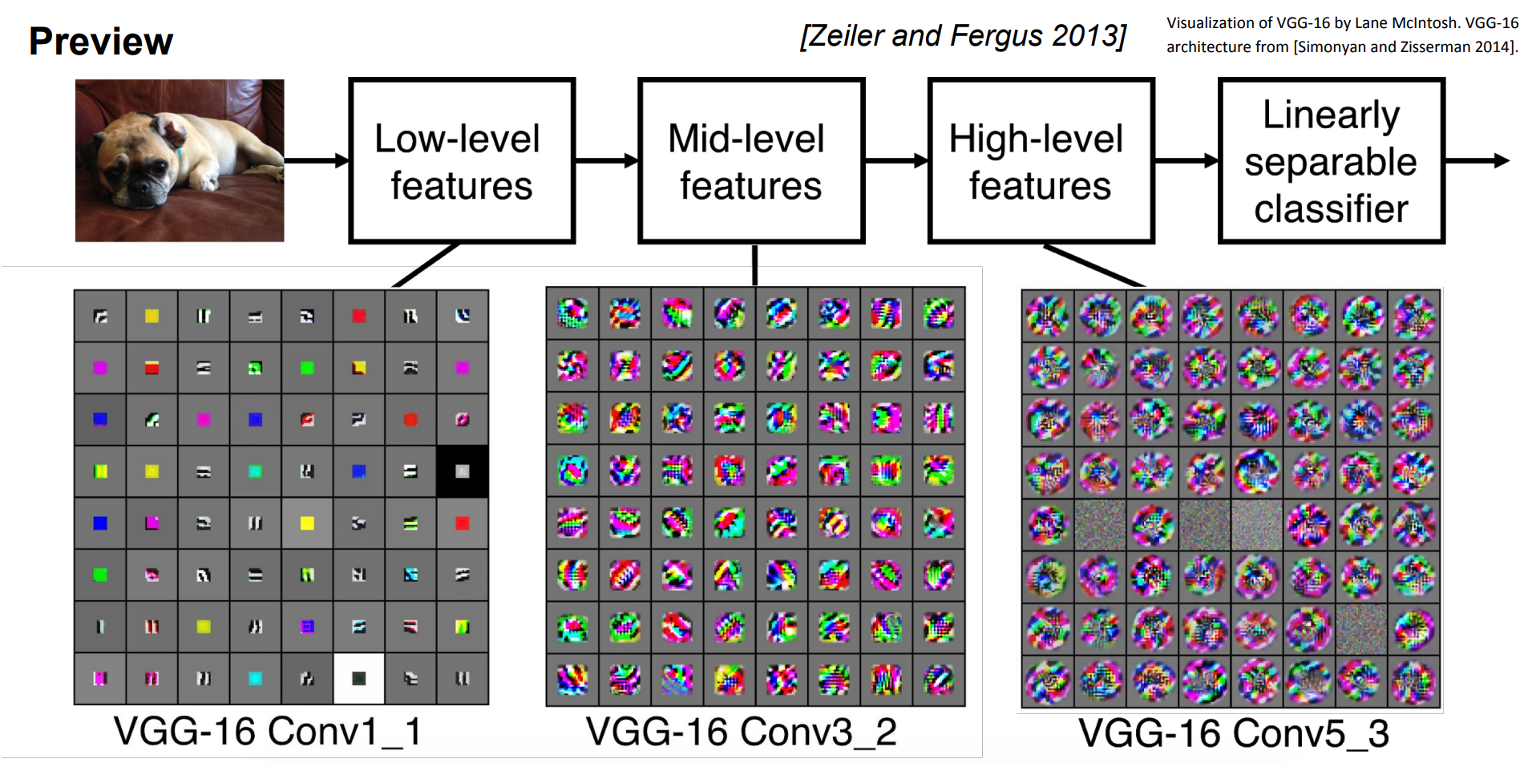

Slide 35
RNNs
Review of RNNs
RNN Language Models
Vanishing Gradient Problem
GRUs
LSTMs

Slide 36
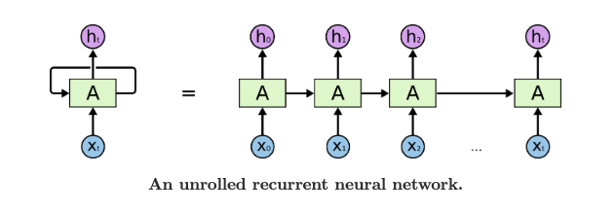
RNNs are good for:
Learning representations for sequential data with temporal relationships
Predictions can be made at every timestep, or at the end of a sequence
Q: How do we incorporate past information to make predictions about the future?

Slide 37
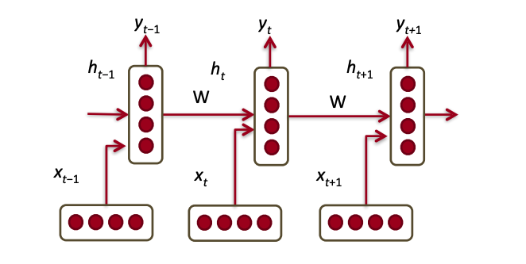
RNNs
Key points:
Weights are shared (tied) across timesteps
Hidden state at time t depends on previous hidden state and new input
Backpropagation across timesteps (use unrolled network)

Slide 38
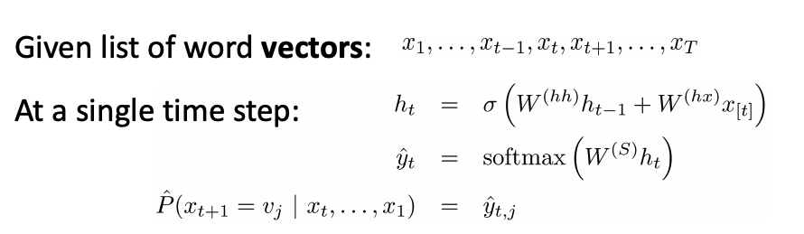
RNN Language Model
Language Modeling (LM): task of computing probability distributions over sequence of words P(w_1, …, w_T)
Important role in speech recognition, text summarization, etc.

Slide 39
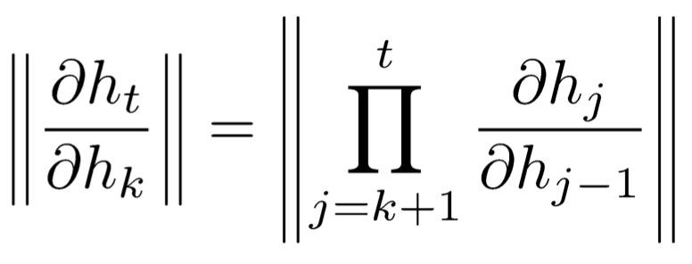
Vanishing Gradient Problem
● Backprop in RNNs: recursive gradient call for hidden layer
● Magnitude of gradients of typical activation functions between 0 and 1.
● When terms less than 1, product can get small very quickly
● Vanishing gradients → RNNs fail to learn, since parameters barely update.
● GRUs and LSTMs to the rescue!

Slide 40
High-Level Idea
Gating mechanisms control information flow:
How much do I care about the past?
How much do I care about the present?
How much do I want to output at the current timestep?
These questions are the underlying mechanisms behind GRUs/LSTMs.

Slide 41
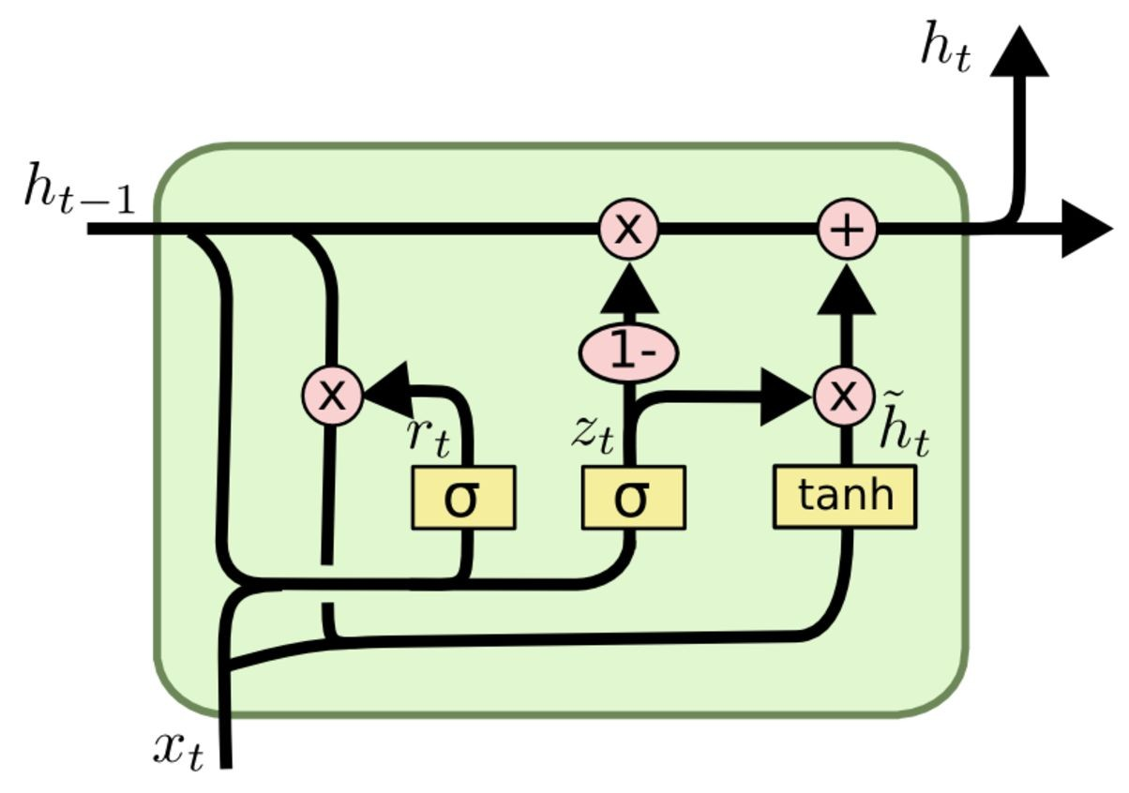
Gated Recurrent Units
Gated Recurrent Units (GRUs)
z_t: Update gate
r_t: Reset gate
h_t: Cell memory content
Mixture of past memory and current memory content
Also functions as cell output
The reset and update gates control long- and short-term dependencies (mitigate vanishing gradients problem!)

Slide 42
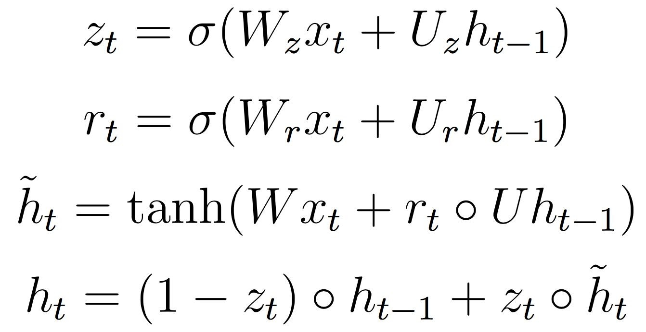
Gated Recurrent Units (GRUs)

Slide 43
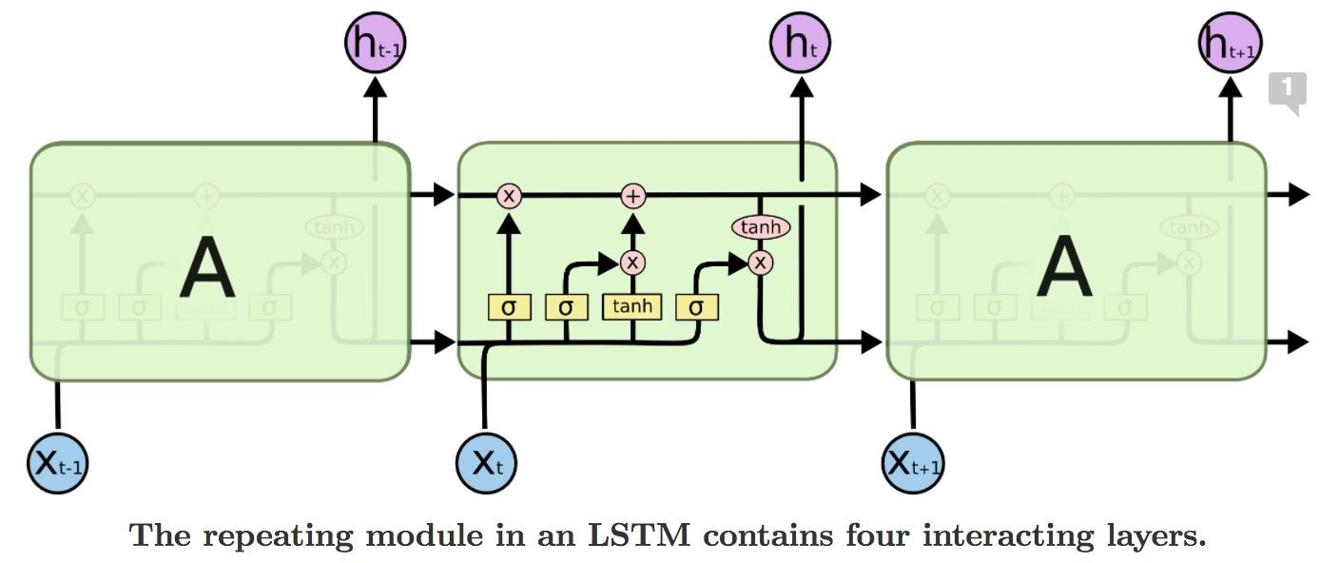
LSTMs
f_t: forget gate
How much do I care about the past?
i_t: input gate
How much do I care about the present?
o_t: output gate
How much information do I output?
C_t: current cell state
h_t: cell output
Cell state + output are separate!

Slide 44
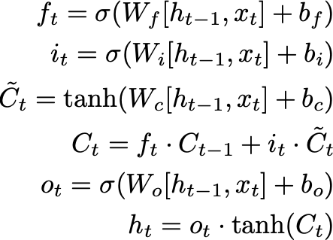
LSTMs

Slide 45
So What’s Missing?
RNNs + variants very successful for variable-length representations/seqs
Gating (LSTMs) for long-range error propagation
But what if we want context from a *really* long time back? (many thousands of steps)
Sequentiability prohibits parallelization within instances
Long-range dependencies are still tricky

Slide 46
Transformer
Architecture
Self-Attention
Multi-Attention Heads
Prediction vs. Sampling

Slide 47
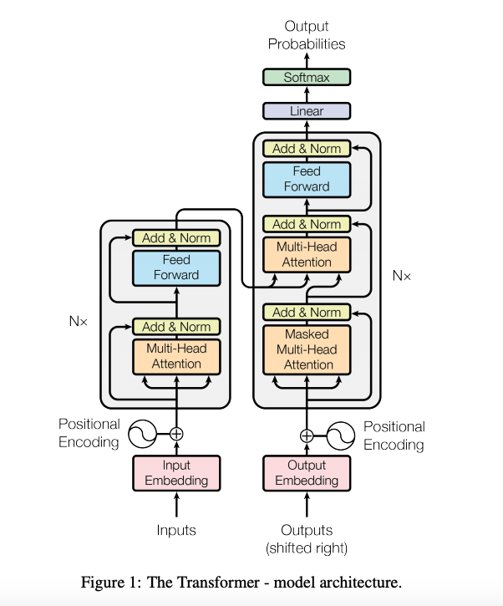
Transformer Architecture
Encoder stack
6 layers, each with 2 sublayers: Multi-head Attention + FFN
Decoder stack
Same as encoder, but with encoder-decoder self-attention
Positional encodings
Added to input embedding

Slide 48
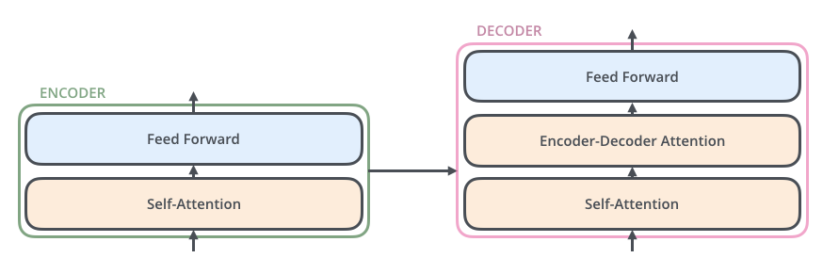
Transformer (Simplified)

Slide 49

Self-Attention

Slide 50
Self-Attention
Key Idea:
Reference by context
Attention: query with vector, and look at similar things in your past
Find most similar key and get values that correspond to these similar things
Softmax gives you probability distribution over keys
Normalize by sqrt(d_k) for numerical stability

Slide 51
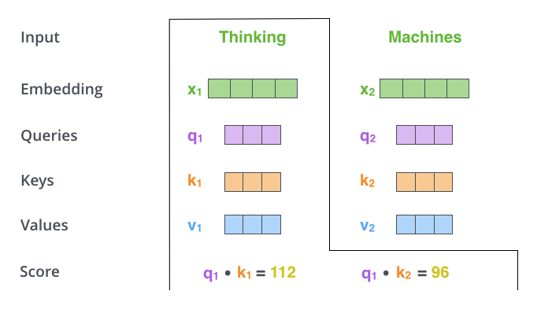
Self-Attention Example

Slide 52
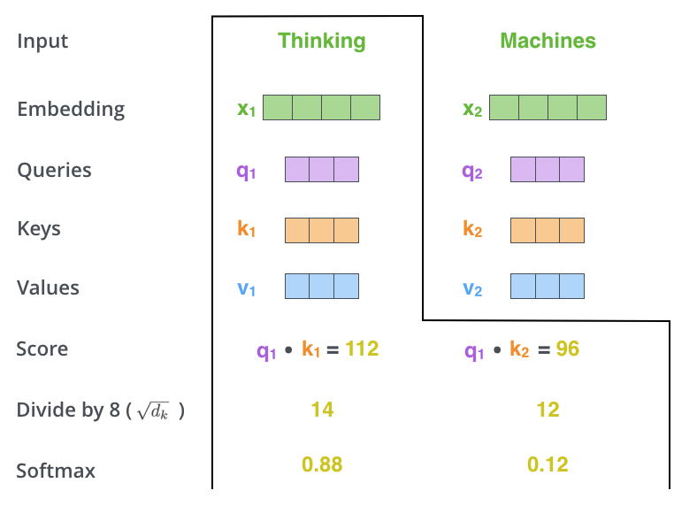
Self-Attention Example

Slide 53
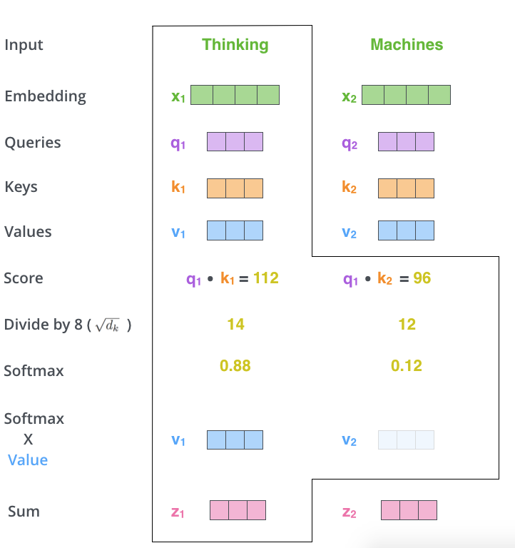
Self-Attention Example

Slide 54
3 Types of Self-Attention
Encoder self-attention: attends everywhere in the input
Encoder-decoder attention (from output, attends to input)
Masked decoder attention: only attends to things before

Slide 55
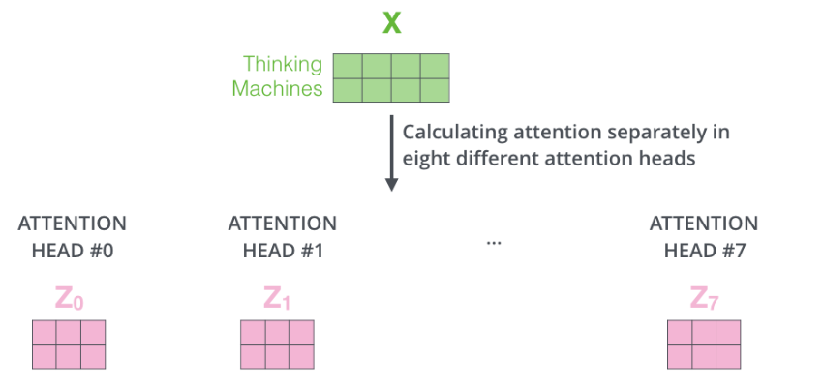
Multi-Attention Heads
Multiple attention heads to get more “representational power”

Slide 56
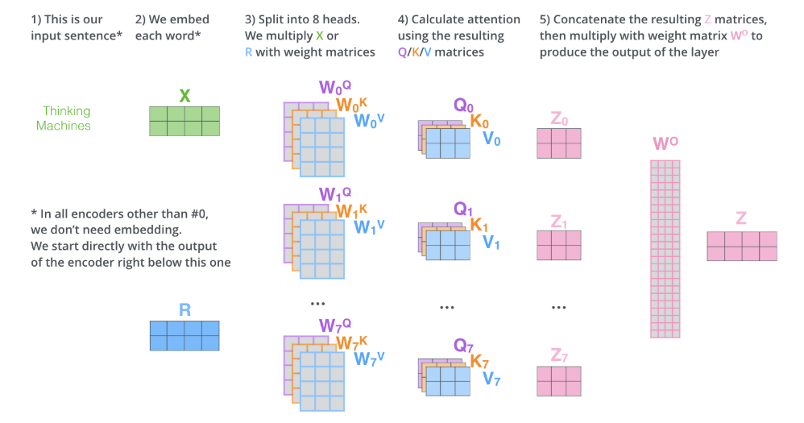
Multi-Attention Heads

Slide 57
Transformer
Final linear layer
Projection of decoder output into a logits vector → each cell corresponds to the score of a unique word in the possible vocabulary
Softmax layer
Turns logits into probabilities, which we use for prediction (training) or sampling (testing/inference)
Cross Entropy Loss
Compare two probability distributions

Slide 58
Transformer: Prediction vs. Sampling
During training, our examples are “labeled” in the sense that we know the true word that we are supposed to decode
During sampling, we don’t know our target
Generate autoregressively, but using as input the previously generated token

Slide 59
Acknowledgements
Slides adapted from:
Justin Johnson, Serena Yeung, and Fei-Fei Li (CS231N, Spring 2018) [slides]
Barak Oshri, Lisa Wang, and Juhi Naik (CS224N, Winter 2017) [slides]
Nish Chintala (CS236, Fall 2018) [slides]
Chris Olah, OpenAI [blog]
Lukasz Kaiser, Google Brain [talk]
Anna Huang and Ashish Vaswani, Google Brain [slides] [paper]
Jay Alammar, [blog]

